Slide 1
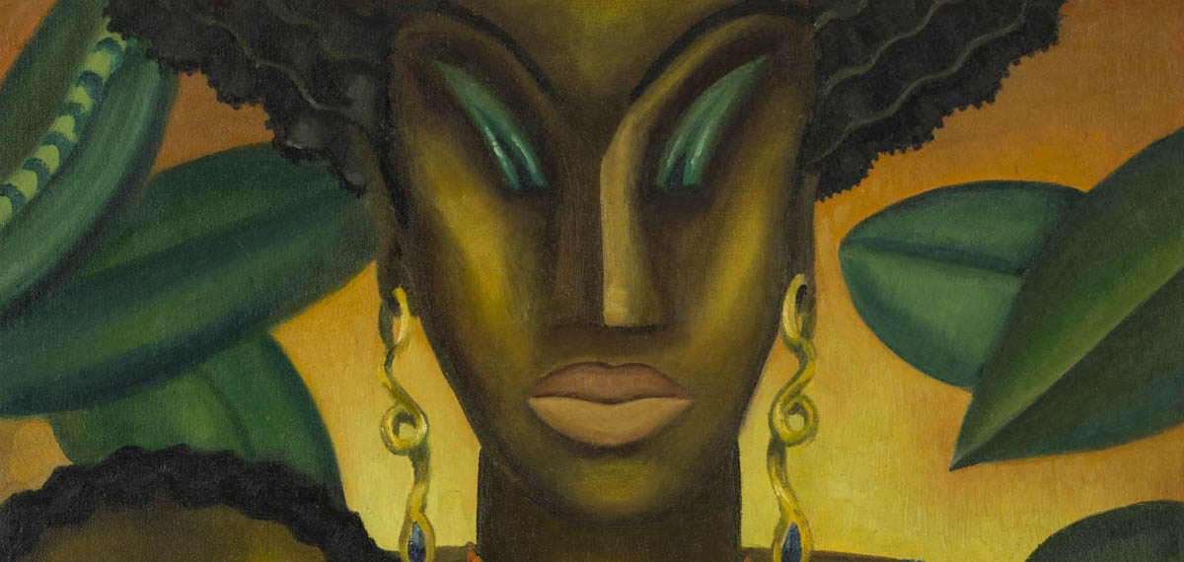


Lois Mailou jones
November 3, 1905 / June 9, 1998
Temesghen Iyasu

Slide 2

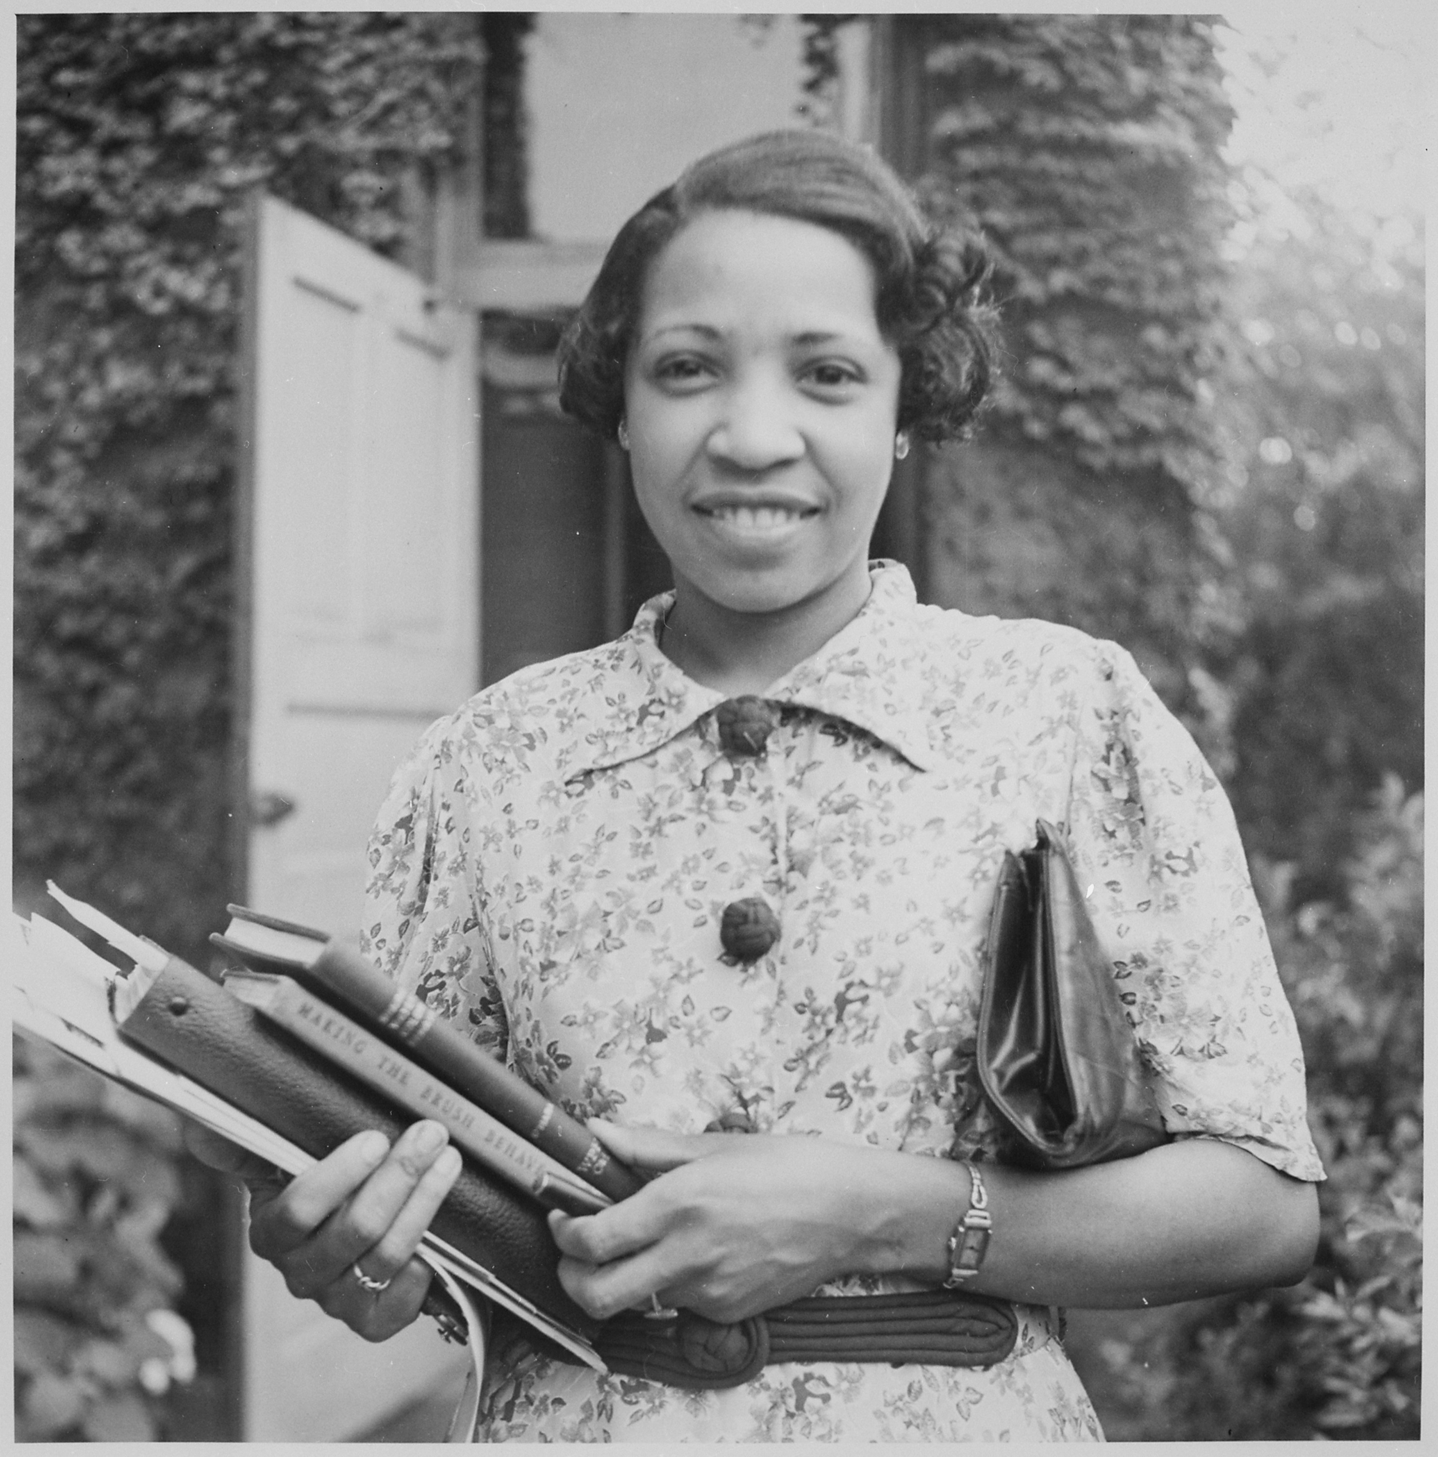


Early Life
* Born in Boston, Massachusetts 1905​
*Early childhood (1905-1928)
* Early career (1928-1936)​
* 1937 – 1953 (Influences from travels to Paris)​
​1954 - 1967 (Influences from travels to Haiti)
1968 – 1970 (Travels to Africa)
1989 – 1998 ( Final years)

Slide 3
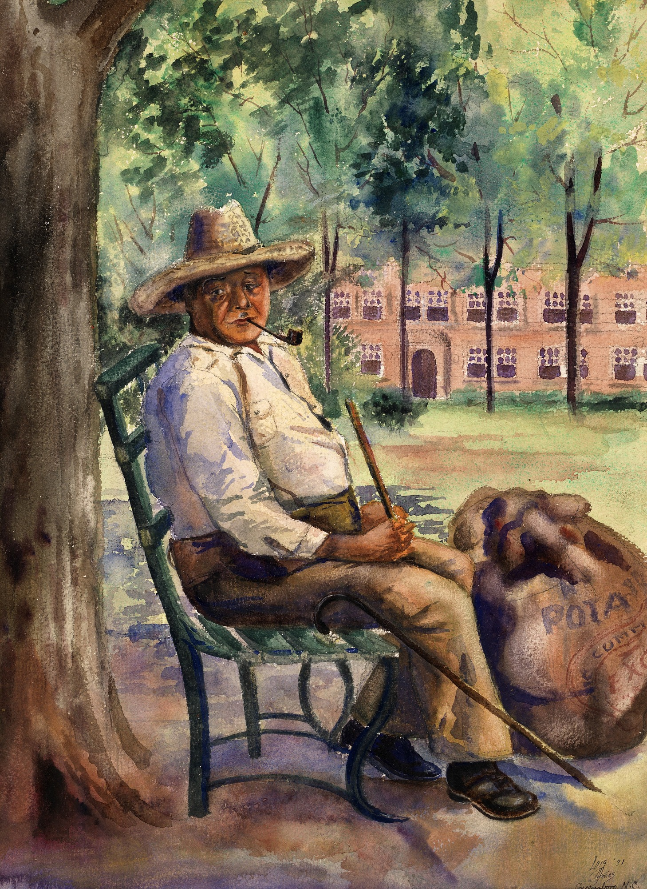
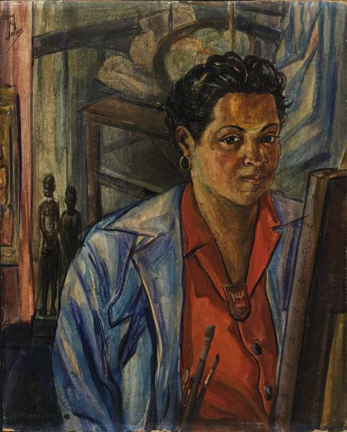
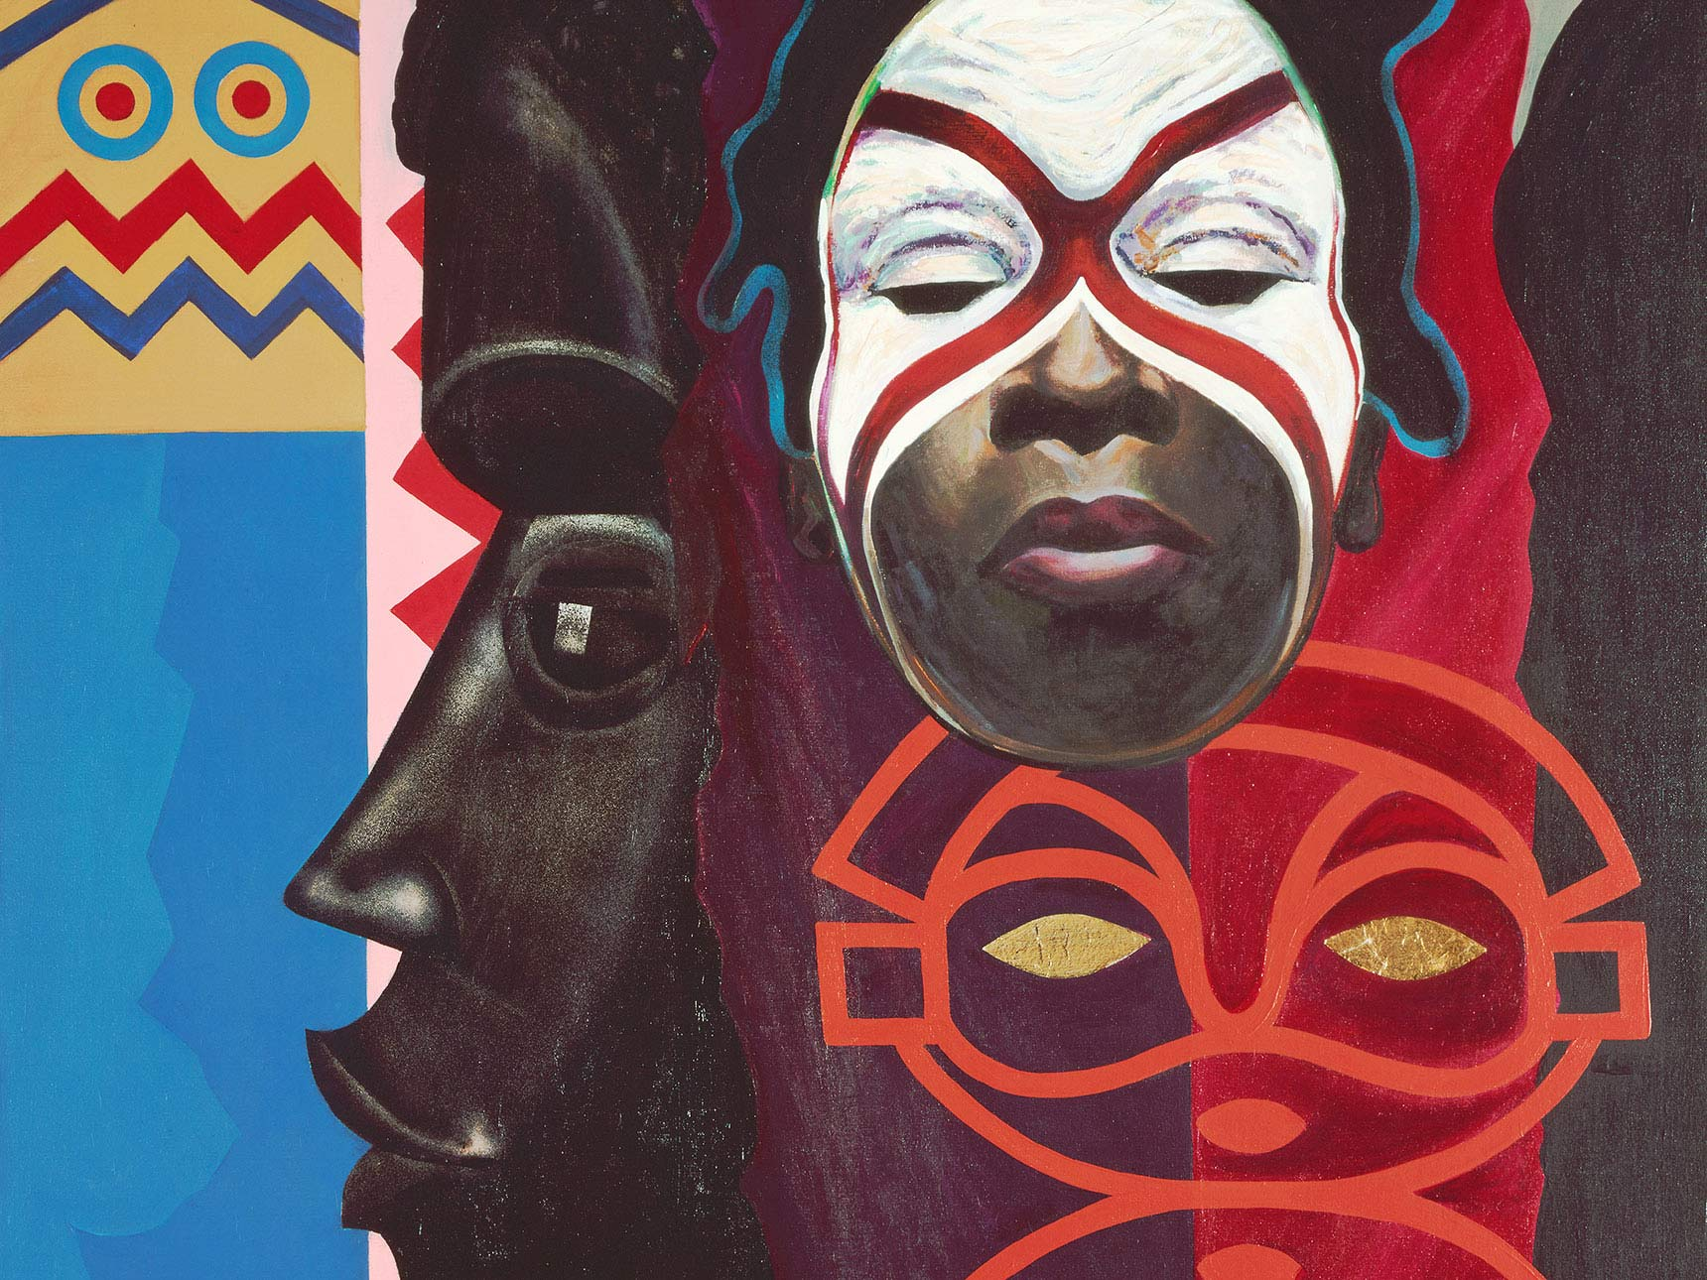
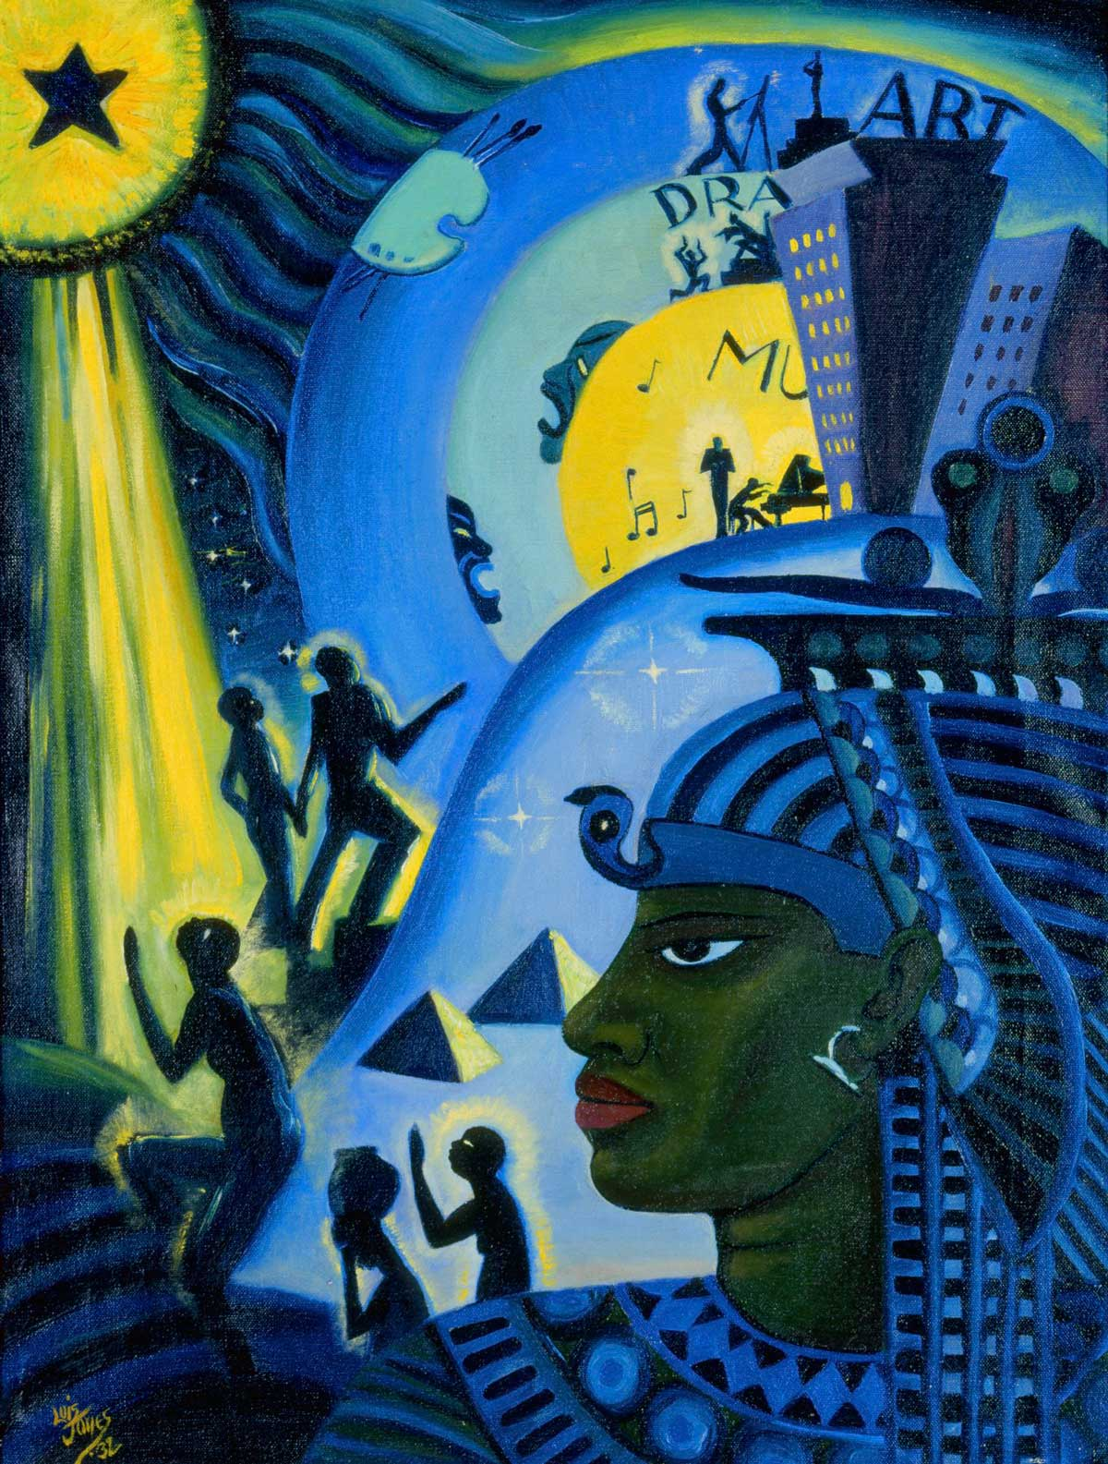
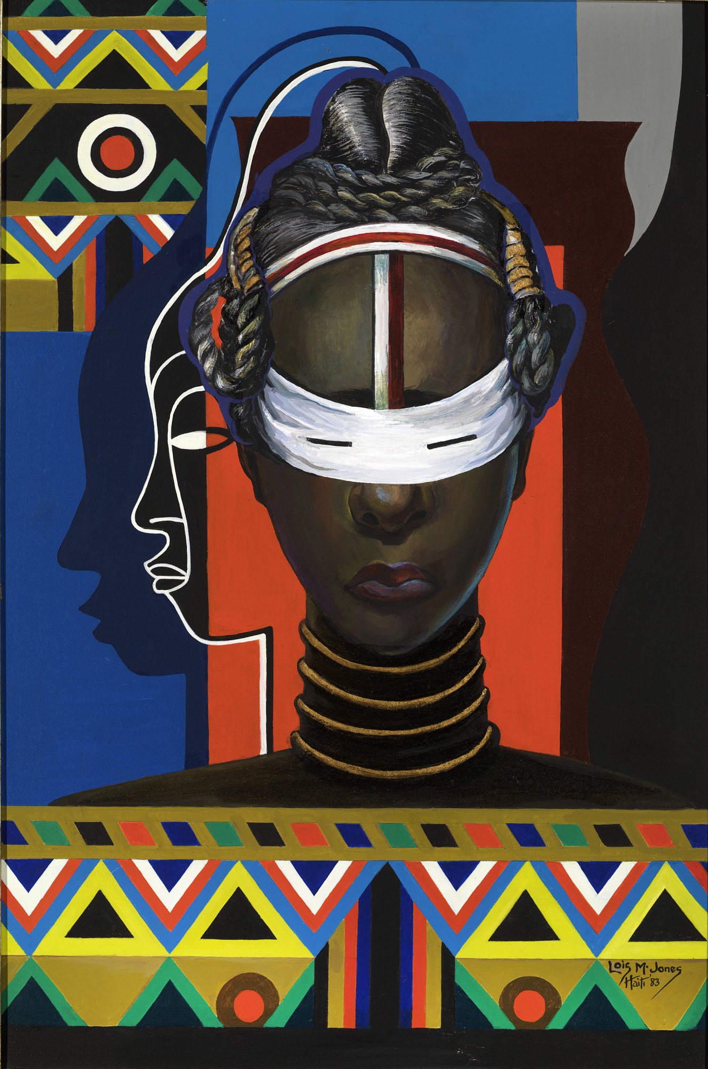
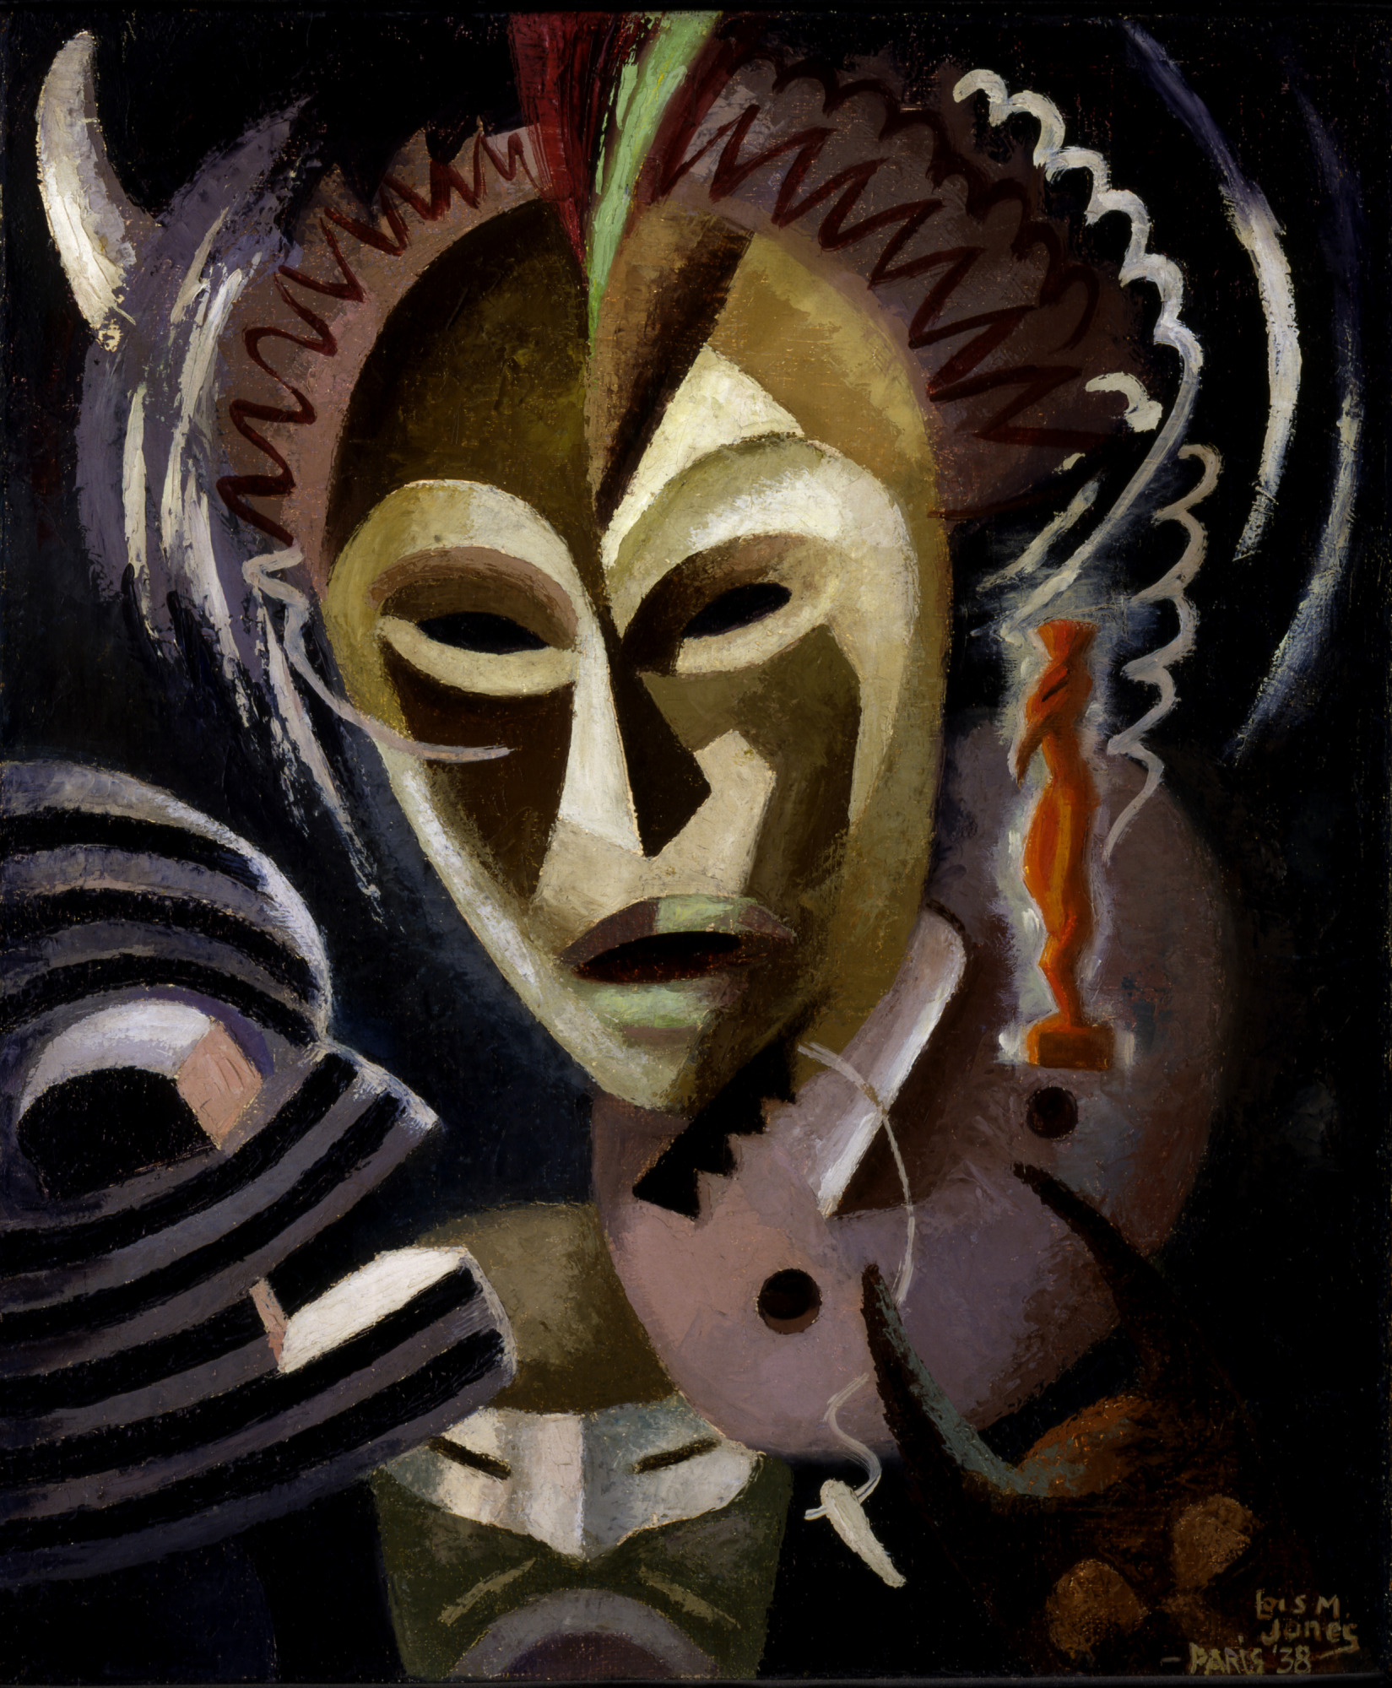
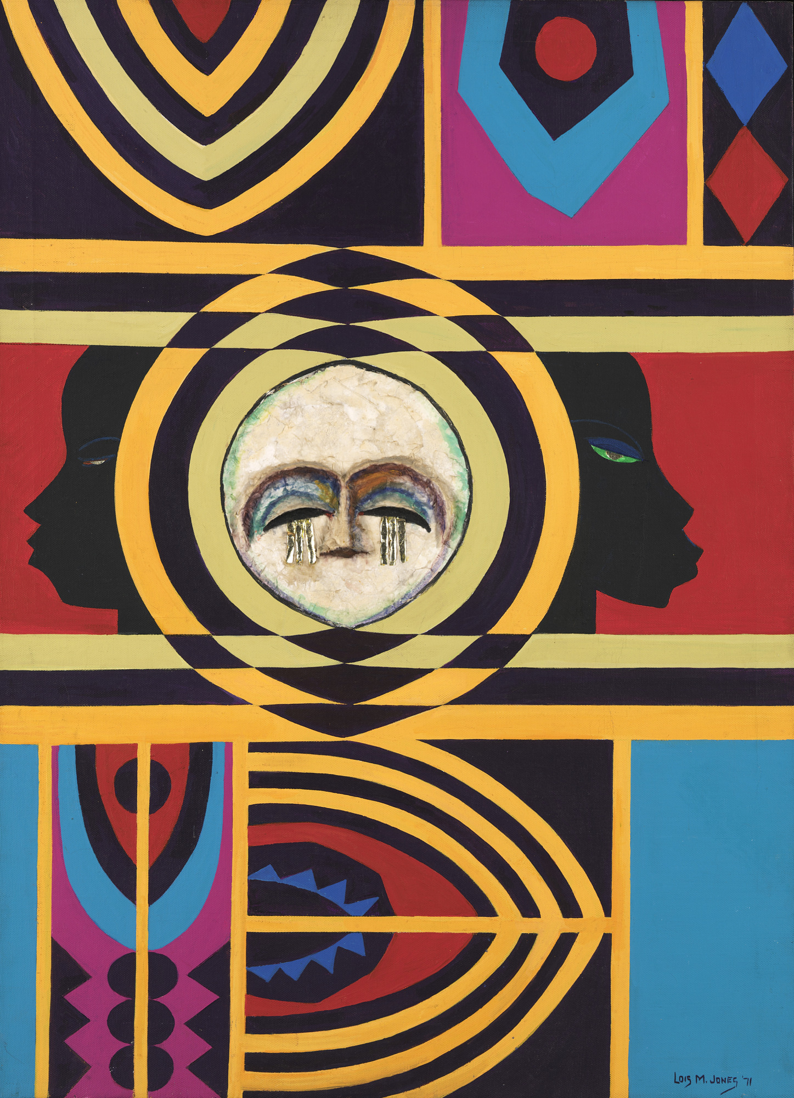
Highlights of her life
Brother Brown 1931
Ubi Girl Tui Region 1972
The Ascent of Ethiopia 1932
Les Fetiches 1938
Self Portrait 1940
Moon Masque 1971
Africa (Biennale) 1935
Initiation of Liberia 1983

Slide 4
Brother brown
Dimensions
18 ¹⁄₂ x 13 ¹⁄₂ in. (47.0 x 34.3 cm)
Painted in 1931, this art piece represents and African American man, sitting on a park bench, smoking a pipe.
Dimensions: 18 ½*13 ½ in.

Slide 5
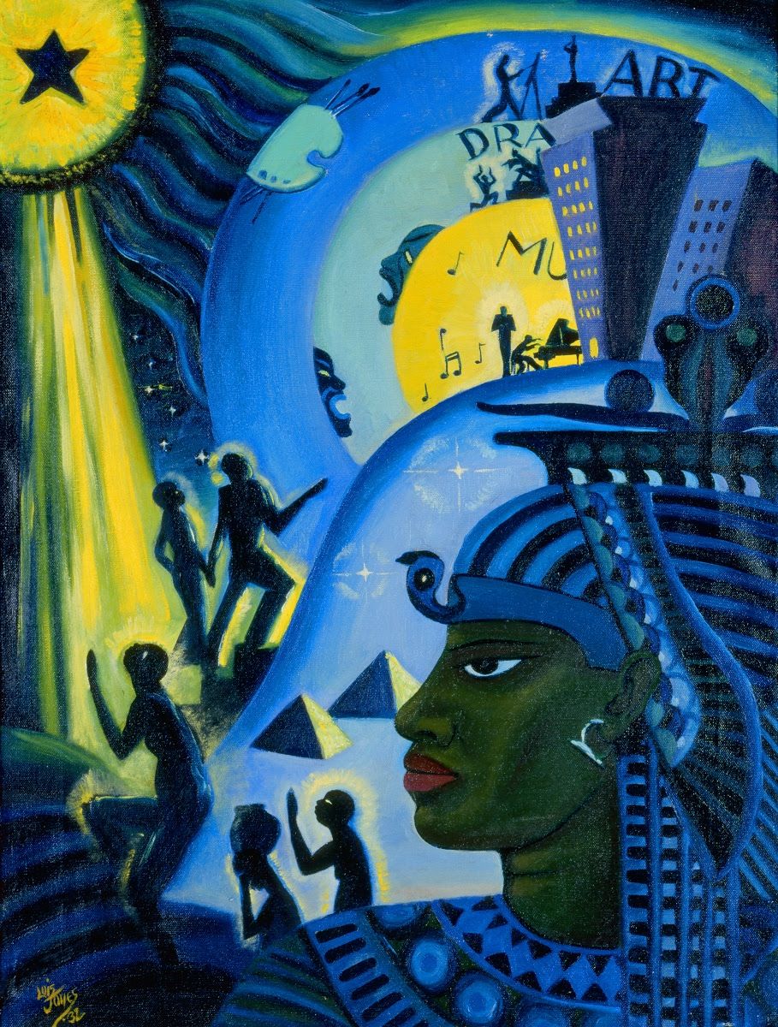
The ascent of Ethiopia
Jones utilized Egyptian themes to communicate the beliefs of the Harlem Renaissance with a hint of the Jazz Age. Here, the pharaoh, figures move up to the modern city, where Black innovation excels.
Oli on canvas
Dimensions: 23 ½ * 17 ¼ in

Slide 6
les fetiches
Five traditional African masks that seem to convey a strange profound aspect brought by ritual dances.
Oil on linen
Dimensions: 25 ½ * 21 ¼ in

Slide 7
Self portrait
The painting not only positions 35-year-old Lois as a serious American artist but also as an African American artist obligated to present her African culture. It was painted in 1940.
Casein on board
Dimensions: 17 ½ * 14 ½ in

Slide 8
Moon masque
The Moon Mosque is a stunning piece of vibrant color and striking de Masklike profiles and designs drawn from Ethiopian textiles.
Oil and collage on canvas
Dimensions: 41* 30 1/8 in

Slide 9
Ubi girl tui region
"Ubi Girl from Tai Region" depicts a young woman from the Tai Region of Liberia whose face is painted for the initiation into womanhood.
Acrylic on canvas
Dimensions: 43 ¾ * 60 in

Slide 10
Africa
This 1935 painting depicting three women with chiseled features, gash-like closed eyes, and elaborate gold jewelry, who are surrounded by lush foliage.
Oil on canvas
Dimensions: 61 * 51 cm

Slide 11
Awards and honors
Robert Woods Bliss Award for Landscape for Indian Shops Gay Head, Massachusetts (1941)
Atlanta University award for watercolor painting Old House Near Frederick, Virginia (1942)
Women of 1946 award from the National Council of Negro Women (1946)
John Hope Prize for Landscape for Ville d'Houdain, Pas-de-Calais and award from the Corcoran Gallery of Art for Petite Ville en hautes-Pyrenées (1949)
Atlanta University award for Impasse de l'Oratorie, Grasse, France (1952)
Oil painting award from the Corcoran Gallery of Art Coin de la Place Maubert, Paris (1953)
Chevalier of the National Order of Honor and Merit from the government of Haiti. (1954)
Award for design of publication Voici Hätii (1958)
Atlanta University award for Voodoo Worshippers, Haiti and America's National Museum of Art award for Fishing Smacks, Menemsha, Massachusetts (1960)
Elected Fellow of The Royal Society of Arts in London. Receives Franz Bader Award for Oil Painting from National Museum of Art for Peasants on Parade (1962)
Honorary Doctor of Philosophy from Colorado State Christian College (1973)

Slide 12
Awards and honors
Howard University Fine Arts Faculty Award for Excellence in Teaching (1975)
Honored by President Jimmy Carter at the White House for outstanding achievements in the arts (1980).
Honorary Doctorate of Humane Letters from Suffolk University in Boston (1981)
Candace Award, Arts and Letters, National Coalition of 100 Black Women (1982)
Third Annual Art Awards, Washington, DC (1983)
Lois Jones Day, Washington, DC (July 29, 1984)
Outstanding Achievement Award in the Visual Arts, Women's Caucus of Art, Cooper Union, New York, NY (1986)
Honorary Doctorate in Fine Arts from Massachusetts College of Art, Boston (1986)
Honorary Doctorate of Humane Letters from Howard University (1987)
Honorary Doctor of Humane Letters from The Atlanta College of Art (1989)
Honorary Doctor of Fine Arts from the Corcoran School of Art (1996)

